Slide 1
Live Session 4
By Ben Goodwin

Slide 2
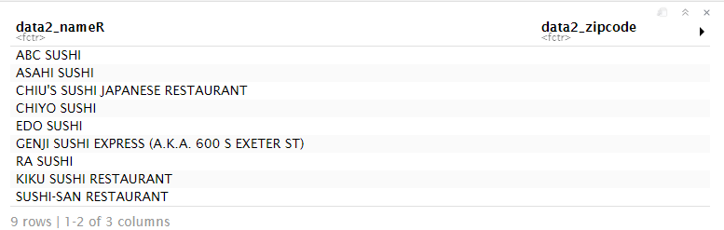
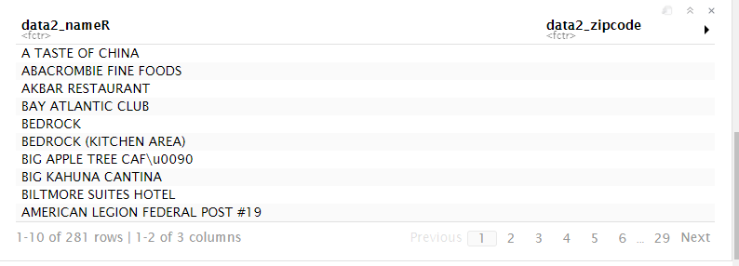
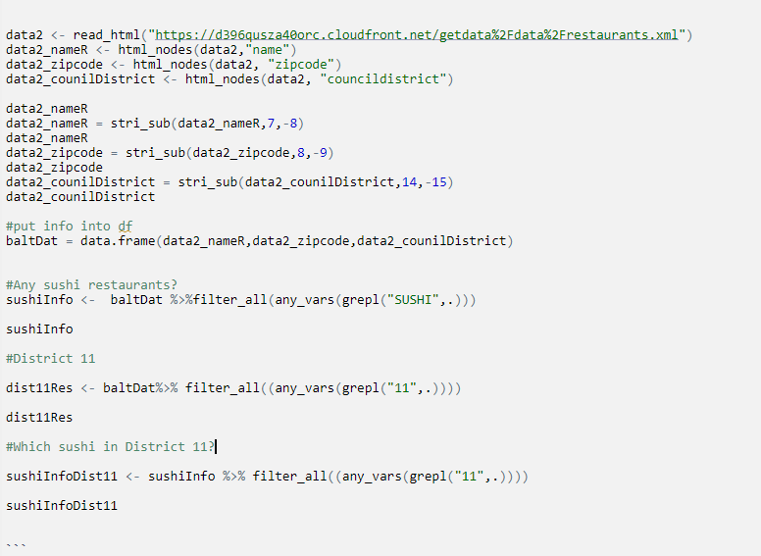
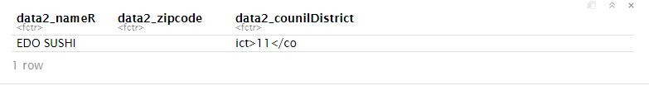
Part 1, Restaurant data from Baltimore (Are there any Sushi restaurants in Baltimore?)
Yes-From the data, we can see there are 9 restaurants in Baltimore that contain the word “SUSHI.”
R Output
Sushi Restaurants
R input
Downtown Restaurants
Sushi Downtown
The data contained: 9 Sushi Restaurants, 281 downtown restaurants, and 1 downtown sushi restaurant.

Slide 3
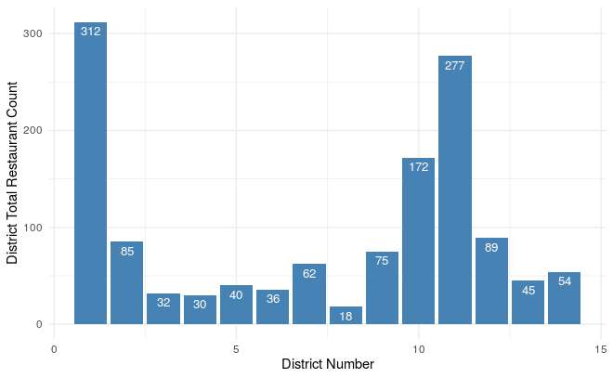
Council District Restaurant Count

Slide 4
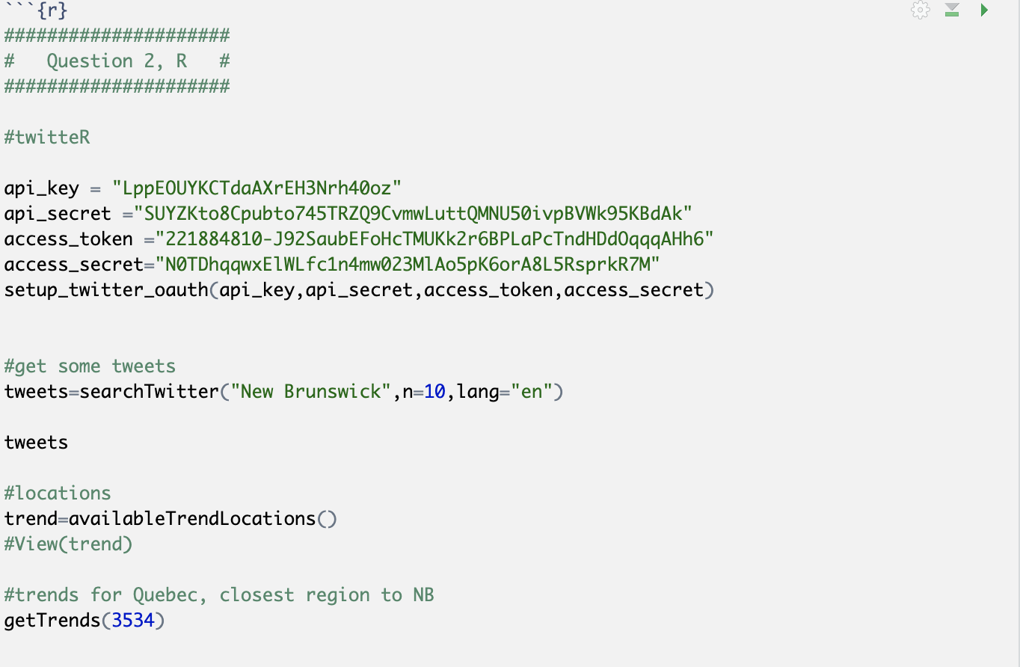
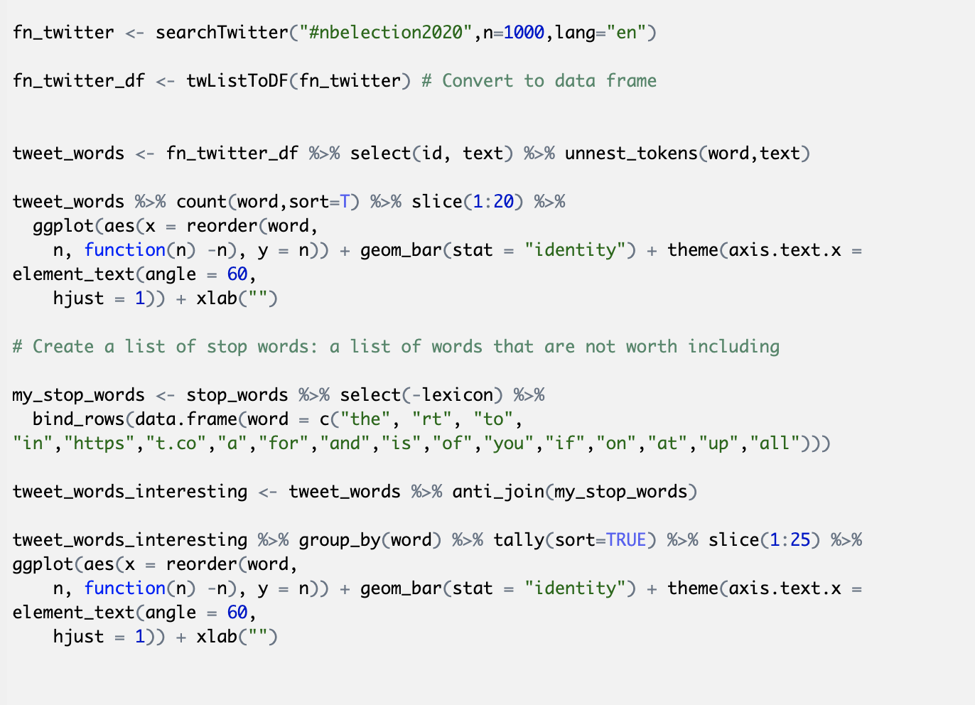
Part 2, Twitter API
Topic of interest, New Brunswick 2020 Elections
Step 1, access Twitter API. Then scrape for NB
Election data.
Search twitter by hashtag, plot results. Remove stop words, plot relevant keywords

Slide 5
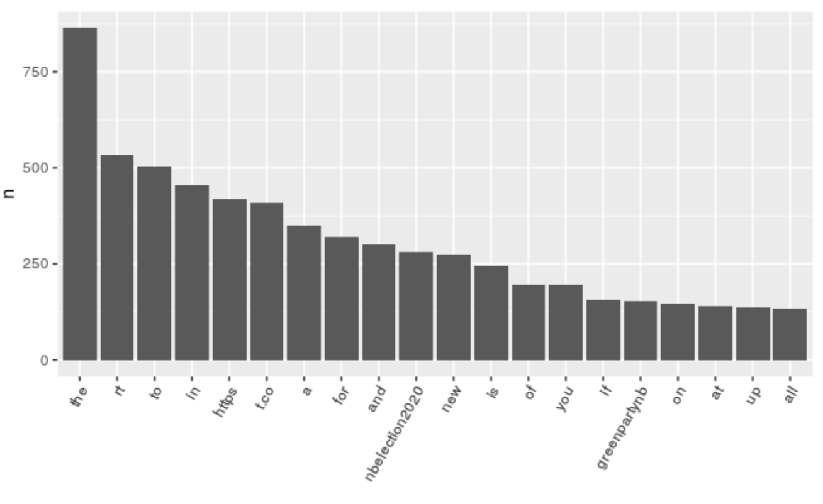
Part 2, Twitter API Results
Search results contain lots of “seemingly” useless information. “Stop words”
Need to clean up results

Slide 6
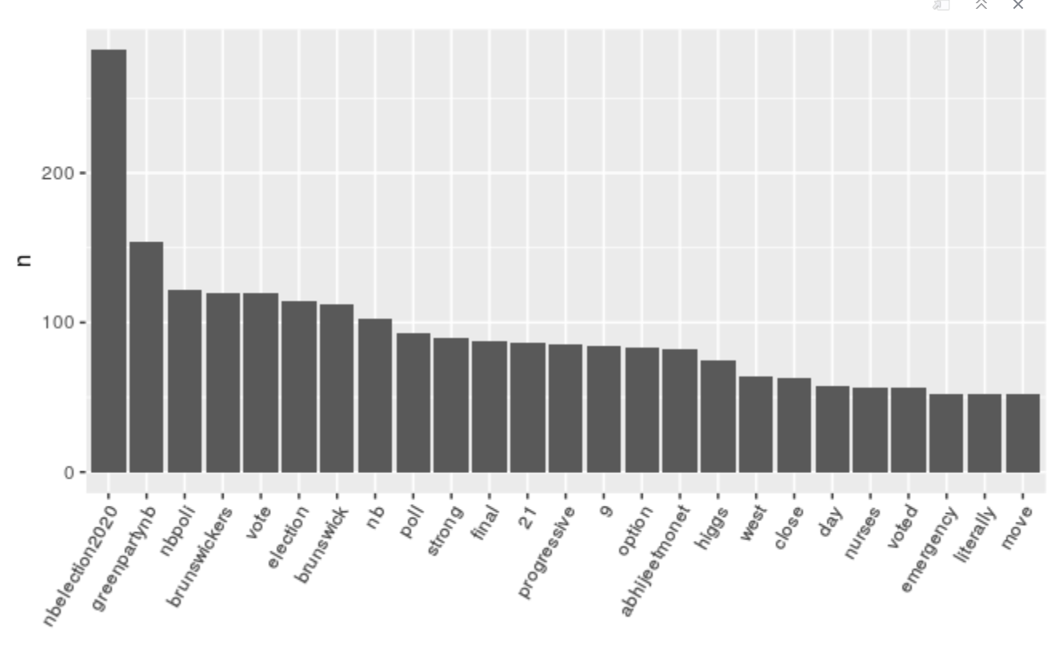
Part 2, Twitter API
Same results, with certain stop words removed.

Slide 7
Conclusions
The Twitter API is fascinating and was very easy to start using. A key benefit for me was the ability to use the functionality in R.
I think the biggest struggle in this section is beginning to extract the data, Twitter is nice because it has built in functionality for data analysis. A company with greater restrictions on data could be much more difficult to scrape.

